Slide 1
Plagiarism and Classroom Behavior
College Prep
Mr. Gordon
jgordon@bisdtx.org

Slide 2
Upcoming Events
hi

Slide 3
Plagiarism
When writing a paper or creating a powerpoint,
it is always important to not plagiarize your work.
Plagiarism can be either intentional or accidental.
Many professors and teachers will give you a 0%
if they find out you plagiarized work.
There are many programs now to help professors see if your work is original, so don’t do it.
hi

Slide 4
Plagiarism
There are 5 types of plagiarism:
Global Plagiarism: when you copy the entire paper word for word.
Verbatim Plagiarism: when you copy another person’s words or writing.
Paraphrasing Plagiarism: when you rewrite another person’s ideas and present them as your own.
hi

Slide 5
Plagiarism
4. Patchwork Plagiarism: when you piece together different sources and present them as your own
5. Self-Plagiarism: when you copy your own past writing and use it again.
Streefkerk, Raimo. “Types of Plagiarism and How to Recognize Them.” Scribbr, 13 Apr. 2023, www.scribbr.com/plagiarism/types-of-plagiarism.
Remember to always state your sources when writing a paper.
hi

Slide 6
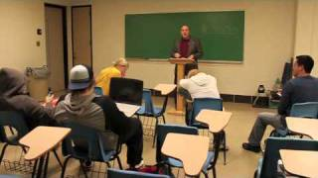
Classroom Behavior Video
hi

Slide 7
Classroom Behavior
Below are some common complaints I have received from professors.
Not doing these things will greatly improve your grades, the behavior of your class, and the mood of your professor.
Remember that every time a student leaves the room, returns, distracts the class, etc.
the professor loses their train of thought and this can be very frustrating.
hi

Slide 8
Classroom Behavior
Being on your phone and not paying attention.
Going to the bathroom. This needs to be done before or after class or during breaks. You should only go during class if it is an emergency.
Coming in late.
Constantly interrupting the class with irrelevant questions
or questions which can be found in the syllabus.
hi

Slide 9
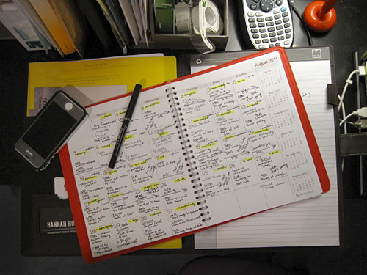
Assignment
In the comment’s section, answer the following question:
List and explain one type of plagiarism.
hi

